Slide 1
DSP Lab
Secure Java Native Interface using JNI and Intel SGX
Group Members :
Clindo Devassy K (2889452) Subhadeep Manna (2793470)
Guidance By: Marcel Blöcher Malte Viering
Notes:
|
| <number>

Slide 2
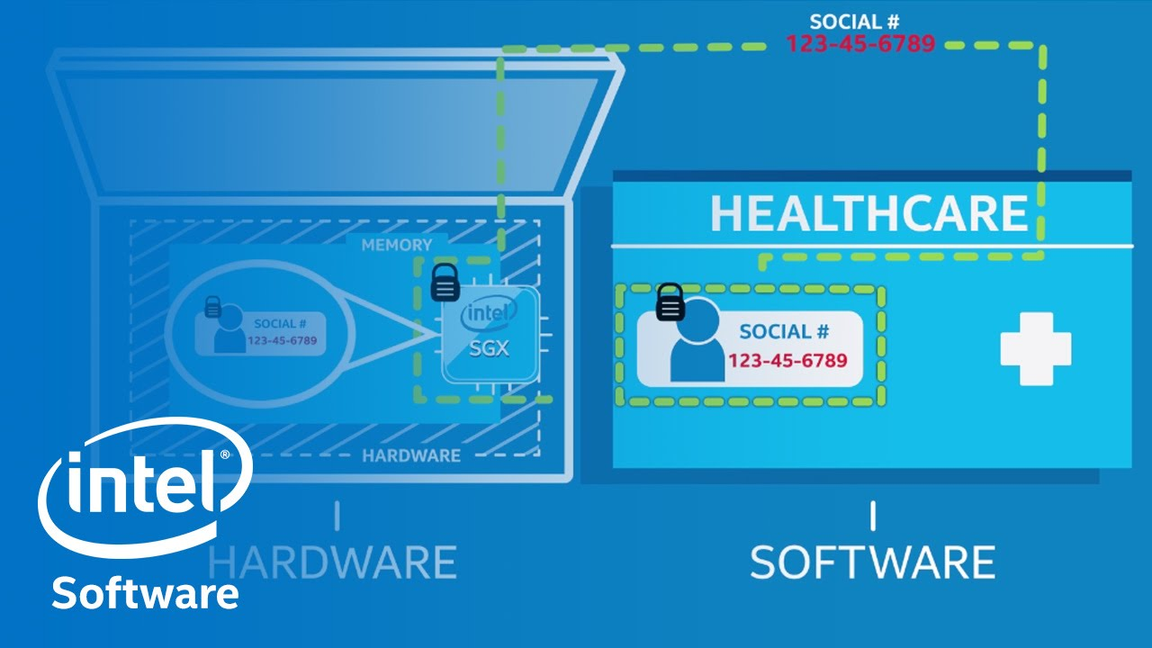
Intel SGX(Quick Look)

Slide 3
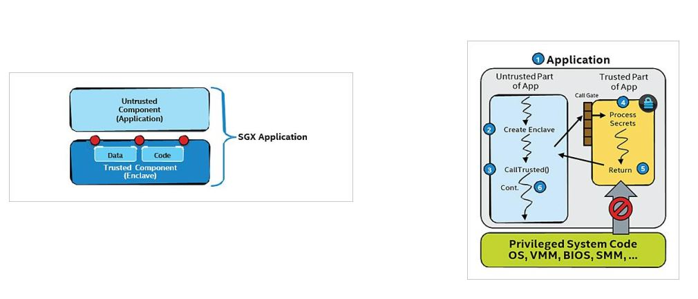
Securing App using Intel SGX (Quick Recap)
Image Source:https://software.intel.com/en-us/sgx/details
Application code can be put into an via the Intel® SGX Software Development Kit (SDK).
Currently available only for C/C++.

Slide 4
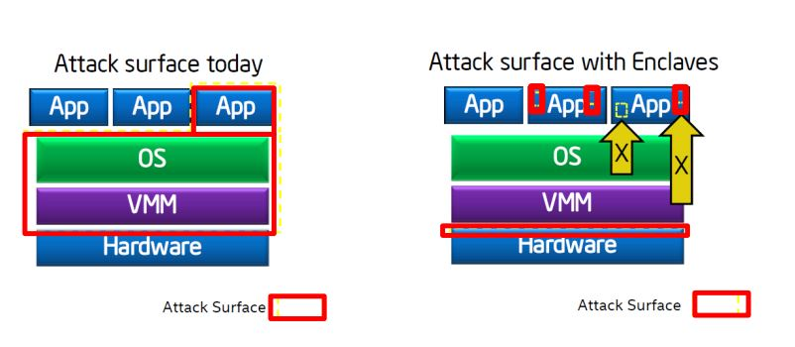
Securing App using Intel SGX (Quick Recap)
  Application gains ability to defend its own secret.
Reduced Attack Surface.
Image Source:https://software.intel.com/en-us/sgx/details

Slide 5
Java Client-Server App (Intel SGX and JNI)
Problem Statement
To implement a Server Side Application using SGX and Java.
It accepts Arithmetic Expressions(Secrets) from Java Clients.
Puts them into the Enclave.
Evaluates them with the code residing in the Enclave.
Return the result the back to the client.

Slide 6
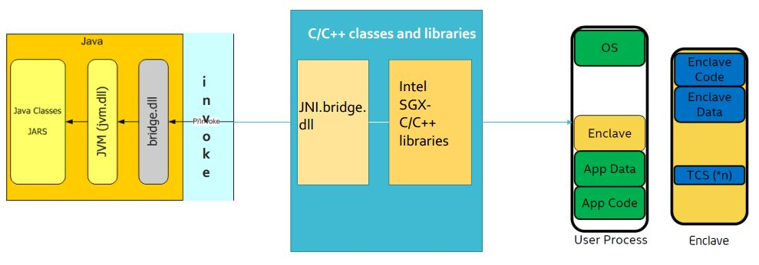
Java Implementation of Intel SGX

Slide 7
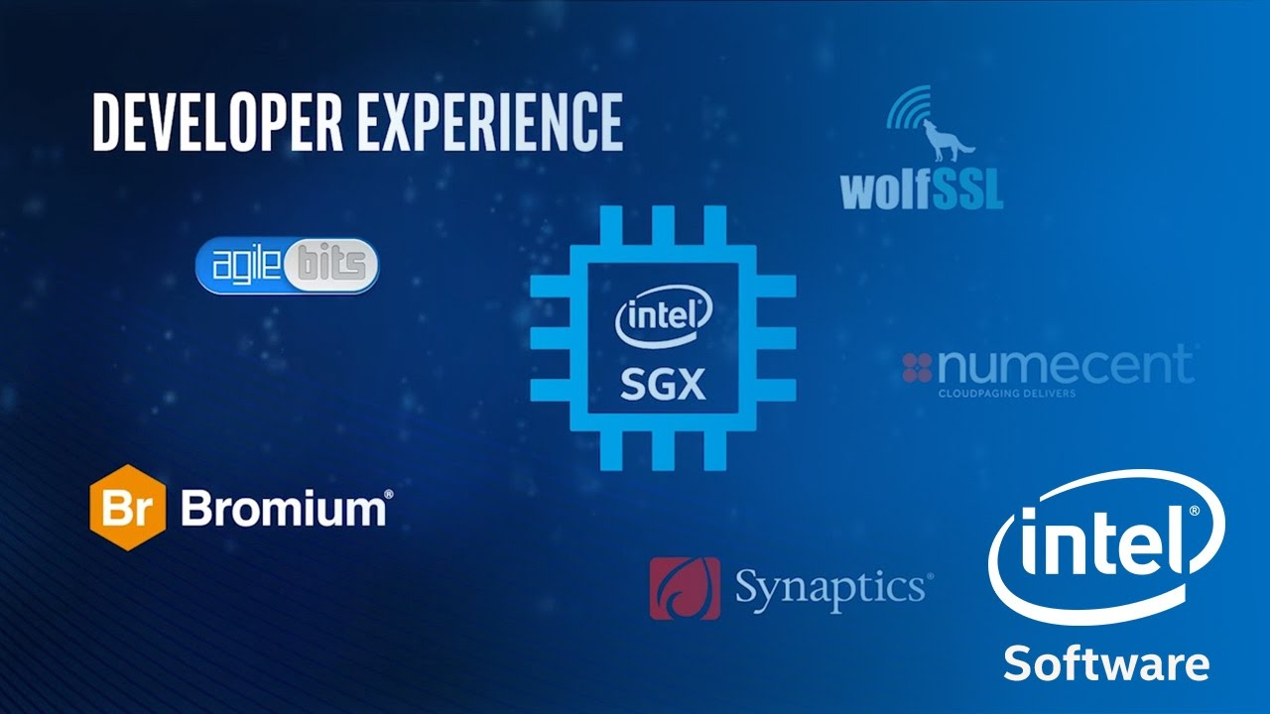
Diving Deep into Enclaves : Core of SGX Technology

Slide 8
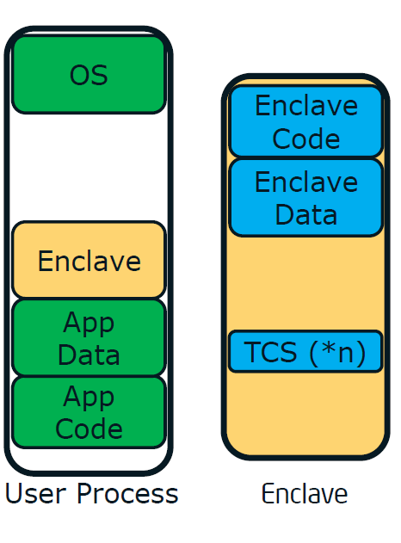
Developer perspective of an SGX Enclave
Trusted execution environment embedded in a process
Intel® SGX generates a cryptographic log of all the build activities
Content: Code, Data, Stack, Heap
Location of each page within the enclave
Security flags being used
Image Source:https://software.intel.com/en-us/sgx/details

Slide 9
The Challenge –
Provisioning Secrets to the Enclave
• An enclave is in the clear before instantiation.
• Secrets come from outside the enclave
– Keys
– Passwords
– Sensitive data
• The enclave must be able to convince a 3rd party that it’s
trustworthy and can be provisioned with the secrets.(Trusted Computing)
• Subsequent runs should be able to use the secrets that
have already been provisioned.

Slide 10
Developer perspective of an SGX Enclave
MRENCLAVE (“Enclave Identity”) is a 256-bit digest of the log
represents the enclave’s software TCB
EREPORT: generates a cryptographic REPORT that binds MRENCLAVE to the target enclave’s REPORT KEY
EGETKEY provides the REPORT KEY to verify the REPORT
A Software TCB verifier should
Securely obtain the enclave’s software TCB
Securely obtain the expected enclave’s software TCB (Ex. Intel own Authentication Server)
Compare the two values

Slide 11
Two ways Intel provides the functionality
Local Attestation.
The process by which one enclave attests its TCB to another enclave on the same platform.
Remote Attestation.
The process by which one enclave attests its TCB to another entity outside of the platform.

Slide 12
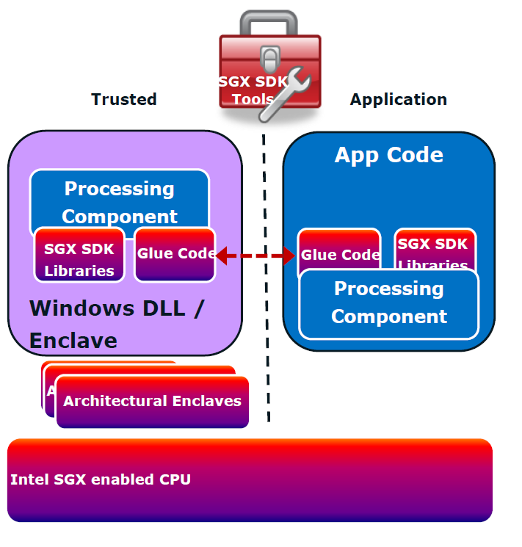
Development of a SGX Application.
From a Developers Perspective:
Create Trusted and Untrusted part of the Application.
Configure Enclave parameters.
Define call to a Enclave(ECALLS)
Define calls from Enclave(OCALLS)
Initialize Enclave.
Add Data and Secrets.
Image Source:https://software.intel.com/en-us/sgx/details

Slide 13
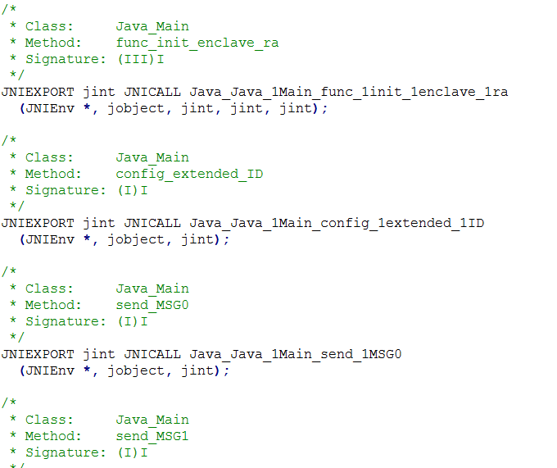
Using Java native interfaces(JNI) in SGX
Initialization of Enclave
Configuration of Enclave
Other function calls to Untrusted part

Slide 14
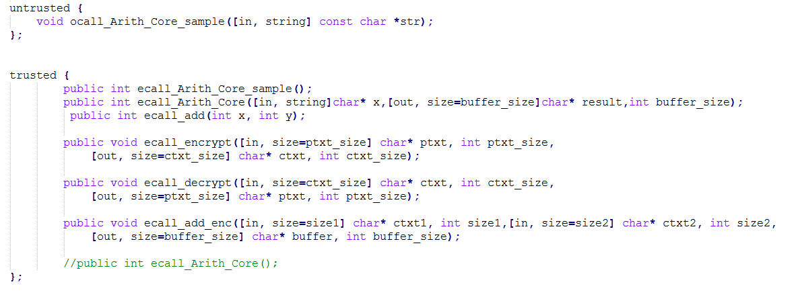
Enclave Description Language(EDL)
Rule of the Thumb:
Trusted part contains all the ECALLS.
Untrusted part contains all the OCALLS of the application.

Slide 15
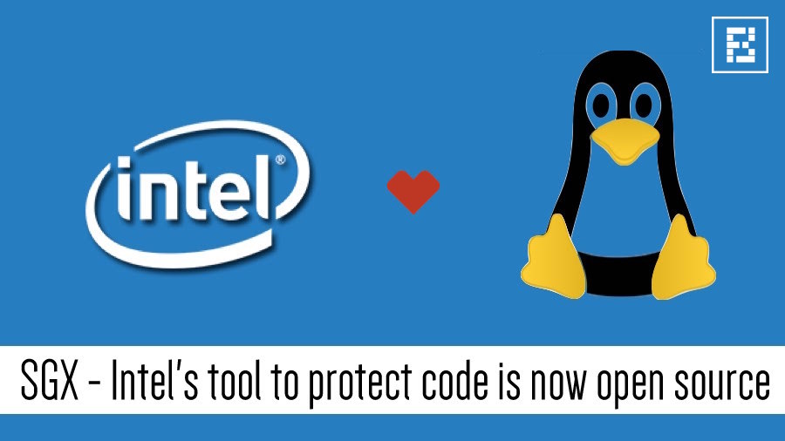
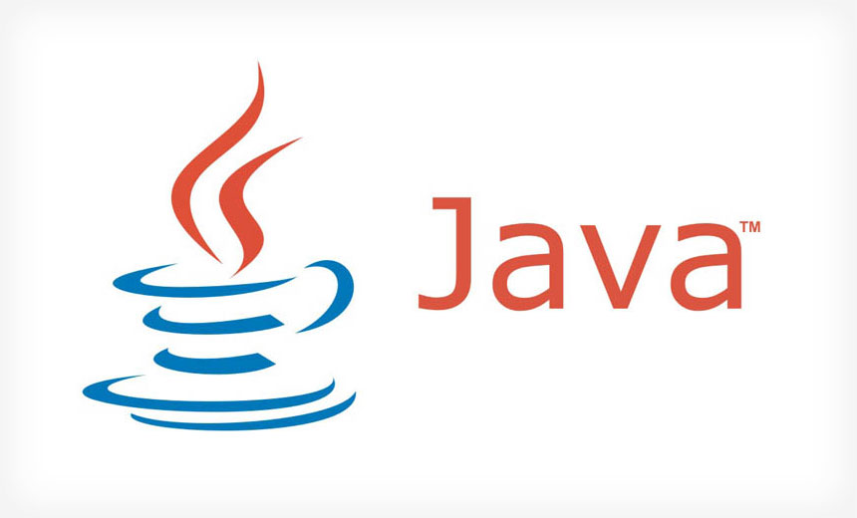
Putting Theory into Practice
+

Slide 16
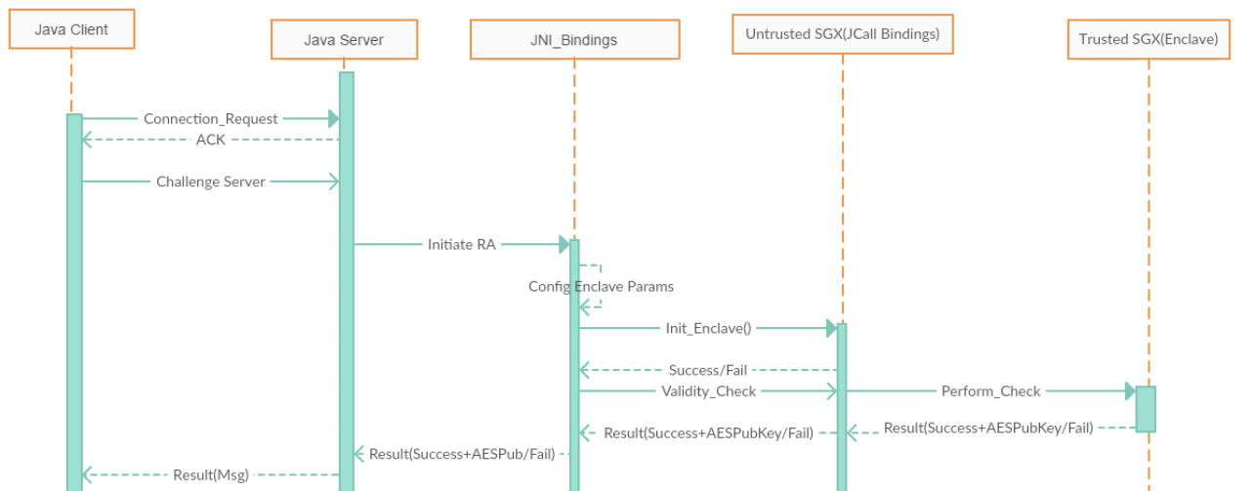
Implementation Sequence Diagram
1. Initialization of Enclave and the Key Exchange with Remote Enclave

Slide 17
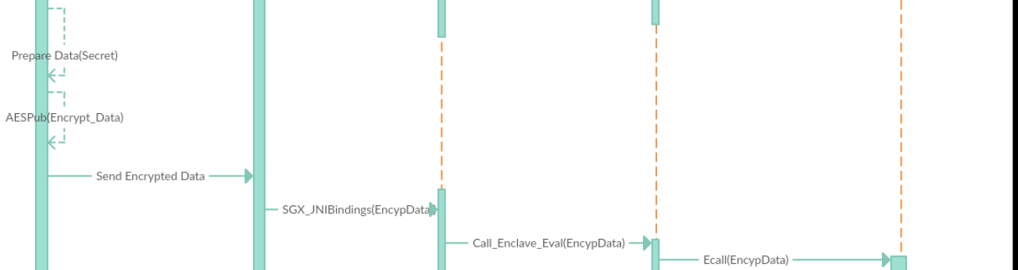
Implementation Sequence Diagram
2. Encryption and Sending of Data to Remote Enclave

Slide 18
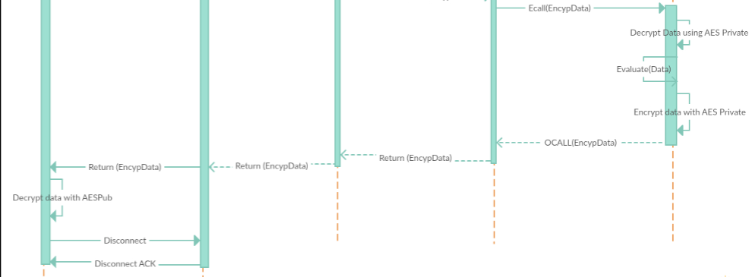
Implementation Sequence Diagram
3. Decryption, Evaluation and Sending Back Encrypted Result to Client from Remote Enclave

Slide 19
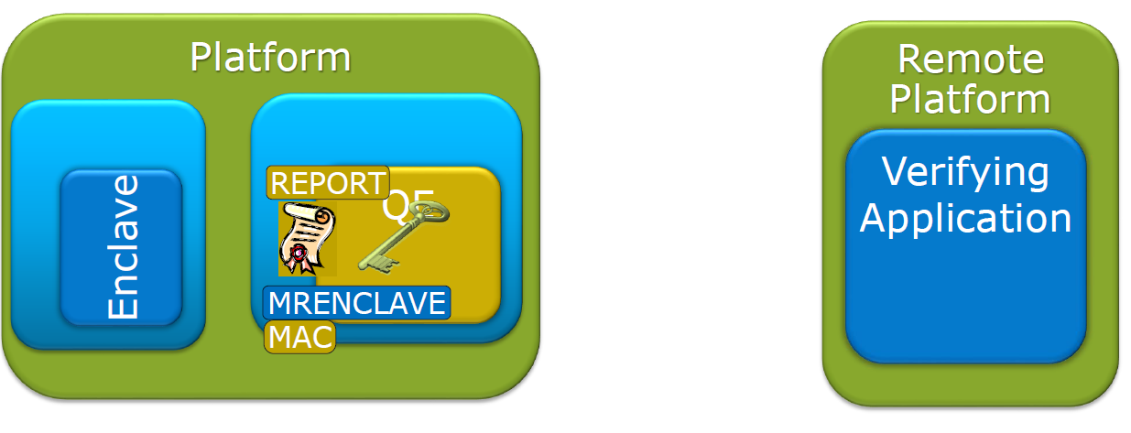
How can a Remote Enclave be trusted?
By procedure of Remote Attestation offered by Intel SGX.
A verifying enclave becomes the Quoting Enclave.
Image Source:https://software.intel.com/en-us/sgx/details

Slide 20
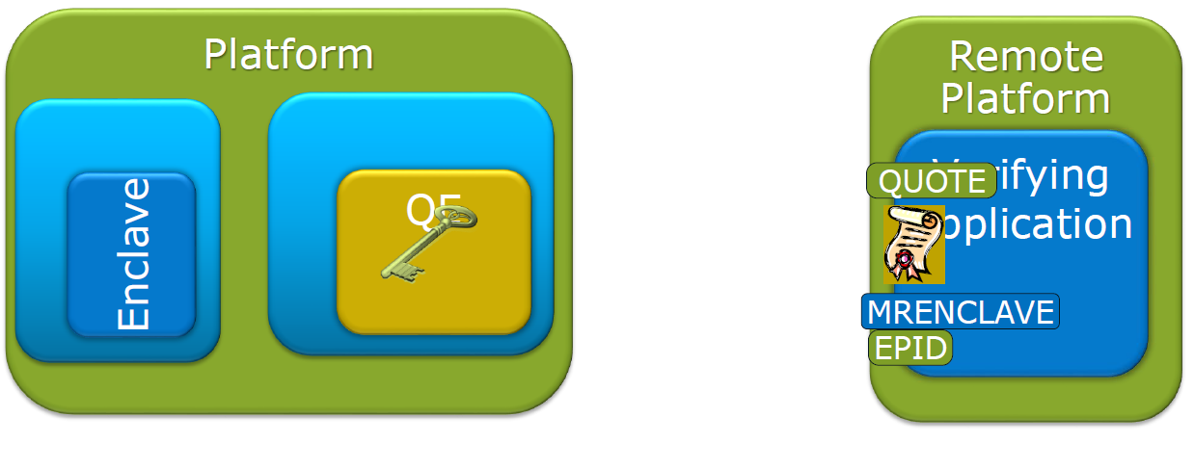
How can a Remote Enclave be trusted?
Remote Attestation by Intel SGX.
After verifying the REPORT the, QE signs the REPORT with
the EPID private key and converts it into a QUOTE.
Image Source:https://software.intel.com/en-us/sgx/details

Slide 21
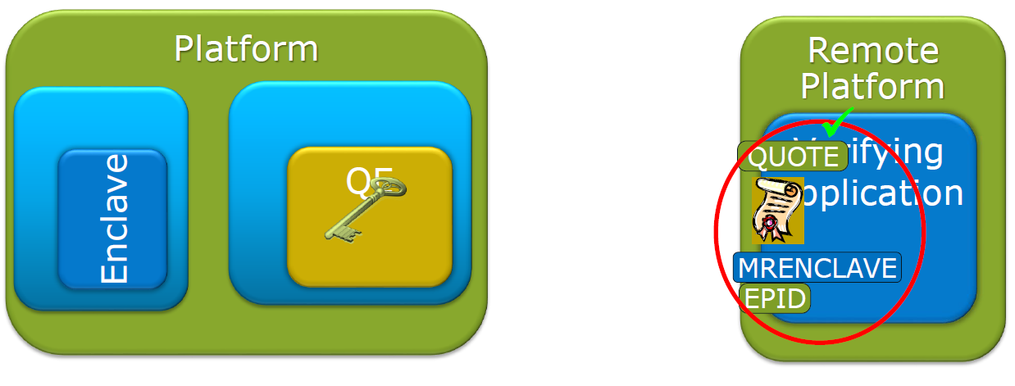
How can a Remote Enclave be trusted?
Remote Attestation by Intel SGX.
Remote platform verifies the QUOTE with the EPID public
key and verifies MRENCLAVE against the expected value
Image Source:https://software.intel.com/en-us/sgx/details

Slide 22
Demo of the Application
Application Demo

Slide 23
Quick Summary of our Application.
Client sends connection request
Server Accepts connection request.
Client challenges the server to verify itself.
Server Encalce verifies itself using Remote Attestation.
On successful verification, server sends the enclave public key to client.
Client sends the secret, encrypted with enclave public key.
Server decrypts and evaluate the secret inside enclave.
Encrypts the result inside enclave and sends back to client.
Client Decrypts the result and displays the result

Slide 24
Conclusion
While Intel SGX provides new paradigm into securing application and its secrets using hardware enabled measures. It is highly platform and hardware dependent.
Using JNI we can access C and C++ code which adds Performance boost to JAVA.
JNI allows JAVA to access some Intel SGX hardware features.
However, JNI uses native languages which mean it has Portability Issue.
Code Debug could be one of the major problems for the developers who use JNI features in JAVA.

Slide 25
Thank You!

